Slide 1

ONEPLUS vs SAMSUNG

Slide 2
Problem Statement
What makes OnePlus a tough competitor of Samsung flagship phones?

Slide 3
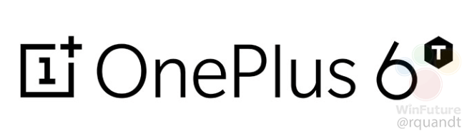
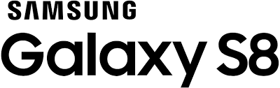

Data Collection Sources: Flipkart, Amazon, Different news articles and GSM Arena.
Amazon – Selenium Web Scraping
Flipkart – Selenium Web Scraping
Articles – BS4 HTML Parser
GSM Arena – BS4 HTML Parser.

Slide 4
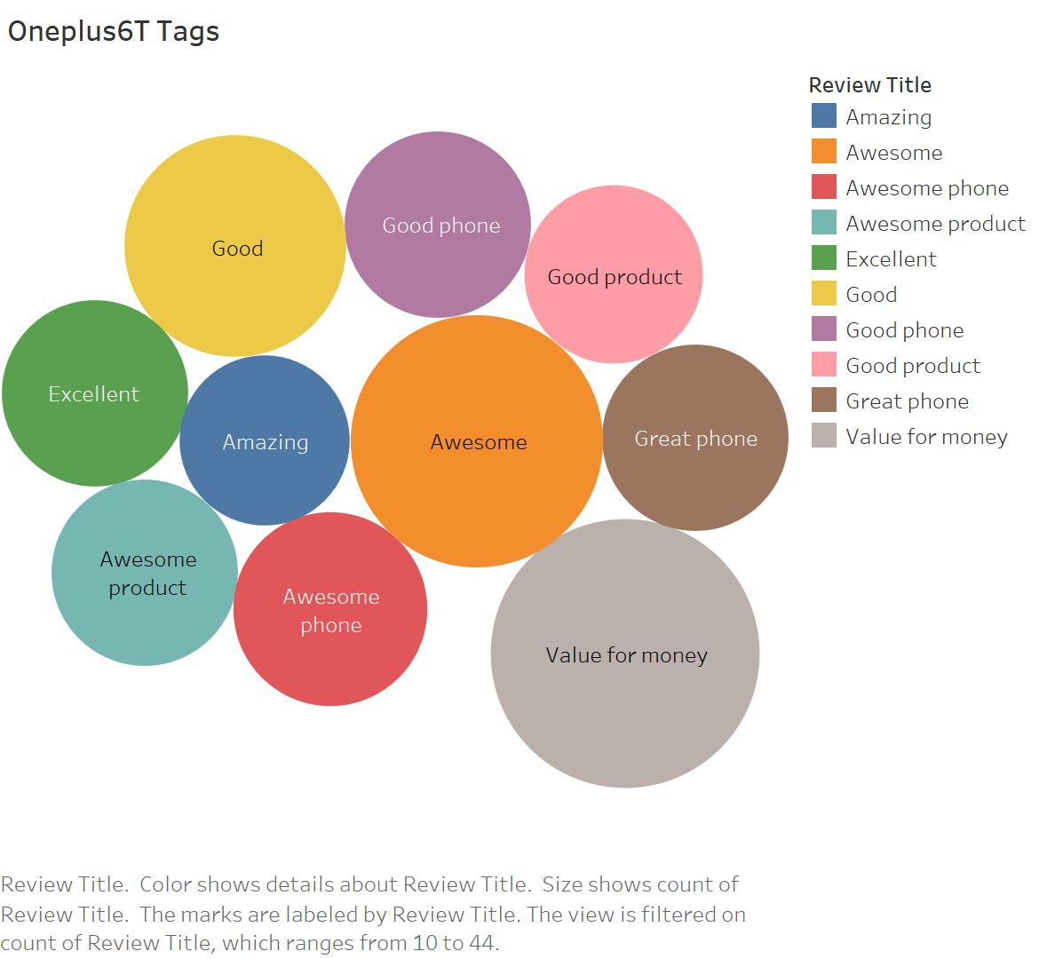
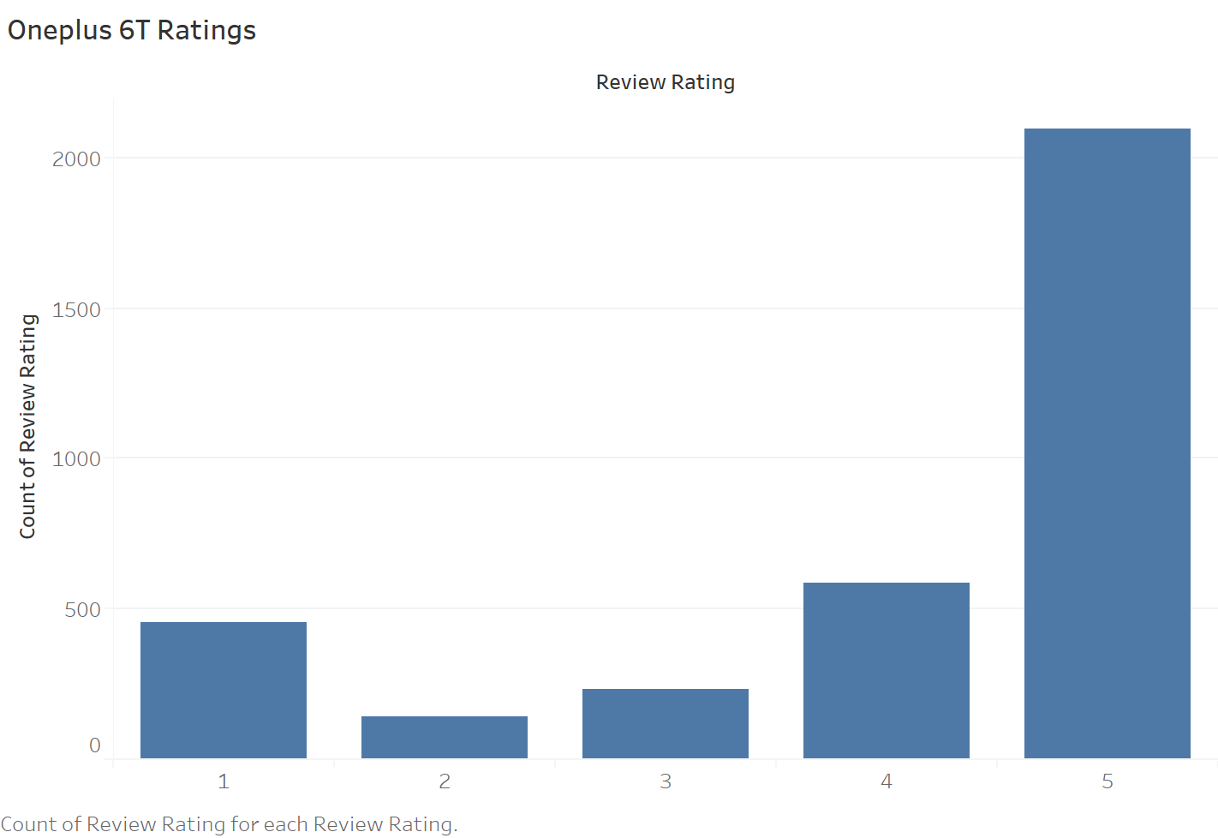
Exploratory Data Analysis – OnePlus 6T

Slide 5
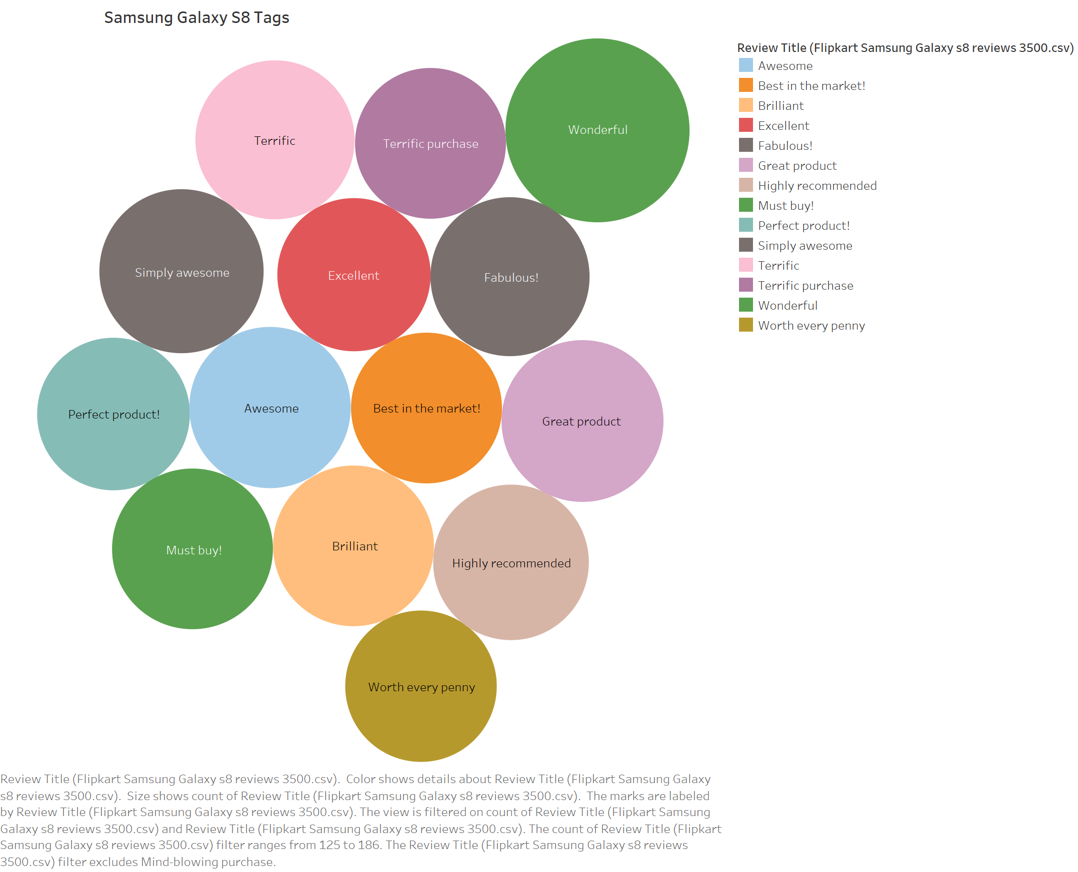
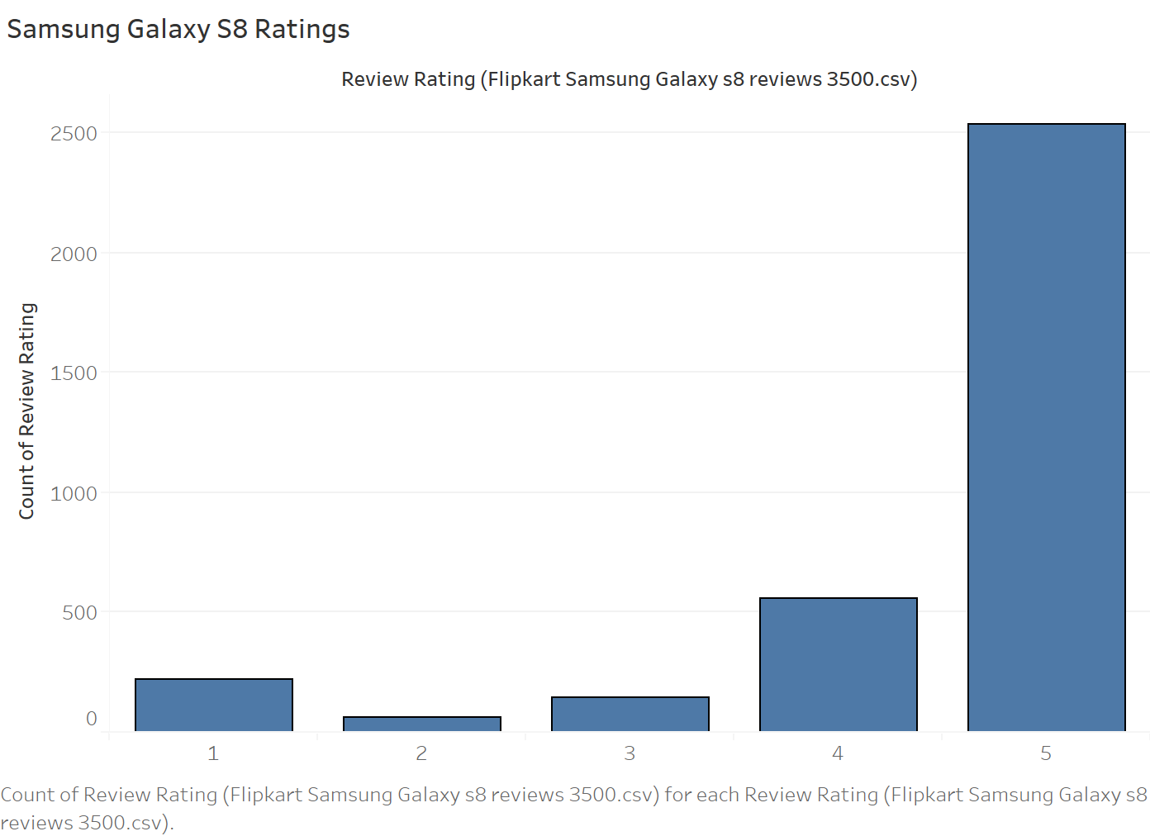
Exploratory Data Analysis – Galaxy S8

Slide 6

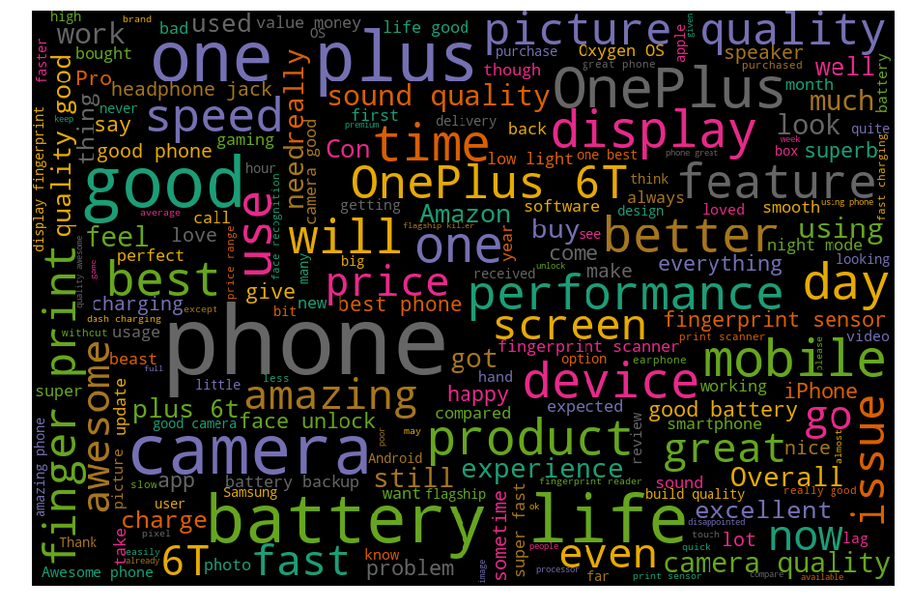
SENTIMENT ANALYSIS – POSITIVE POLARITY
What are the insights derived from the positive opinions?
- SAMSUNG:
Performance, Camera, display, Feature, price.
- ONEPLUS:
Battery Life, Screen, Display, Camera, Feature, Picture Quality, Performance, price, Speed.

Slide 7
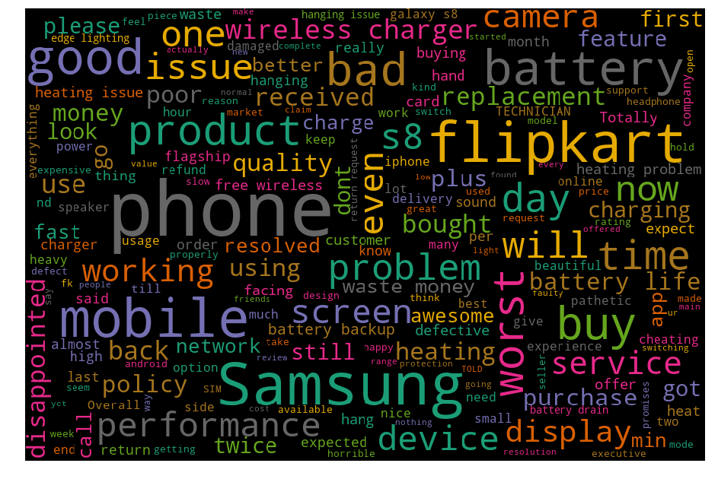
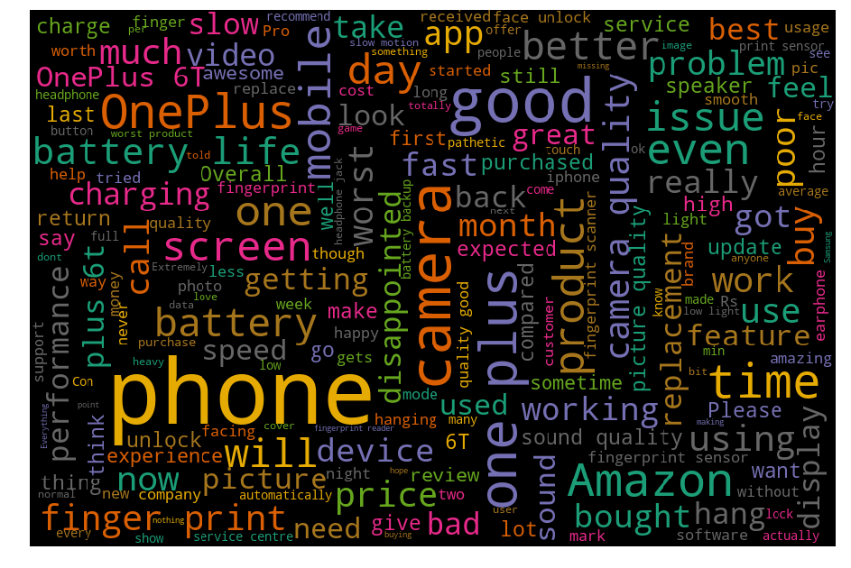
SENTIMENT ANALYSIS – NEGATIVE POLARITY
What are the insights derived from the negative opinions?
- SAMSUNG:
Battery, Worst Service, Wireless Charger, Display, heating, Screen.
- ONEPLUS:
Camera Quality.

Slide 8
Articles Summary -Lex Rank Summarizer
Summaries from different news articles which speak about both the models suggest that, one plus is the best mobile below 30,000 in India.
The summaries also prove the previous analysis(Sentiment analysis) suggesting that the one plus 6T has good battery life and performance in contrast to Samsung S8.
Article Sources: India Today, Business Insider, Tech 2, Gadgets 360, Telecom Talk.

Slide 9
Statistical Analysis
Claim: Difference in the mean ratings of OnePlus and Samsung is statistically significant at 5%. (Assuming the population standard deviation for both the models is equal).
Hypothesis test on the above Sample Statistics reveals that the average ratings of OnePlus is higher than the average rating of Samsung.

Slide 10
Results and Conclusion Tools and Techniques Analysis: R, Python, Tableau
Results:
Analysis reveals that the OnePlus mobile has good battery life, camera and good value for money. There are disadvantages as well but advantages outweigh the disadvantages.
On the other hand, Samsung galaxy phone also gives good value for money with number of features like wireless charger, Excellent camera but lacks to provide basic features like battery life and durability.
Conclusion:
It is not only low price of OnePlus mobile that makes it a tough competitor of Samsung but also the basic features which Samsung flagship mobiles fail to provide.

